Slide 1

Hospital Management System
-Adithya S.T.-18MIS1025
-Harishkumar M-18MIS1031
-Praveen G.K.-18MIS1034
-Dhilipkumar M-18MIS1112

Slide 2
Abstract
Hospitals are the essential part of our lives, providing best medical facilities from various ailments, which may be due to change in climatic conditions, increased work-load, emotional trauma stress etc.
It is necessary for the hospitals to keep the track of its day-to-day activities and records of its patients, doctors, nurses, ward boys and other staff personals that keep the hospital running smoothly and successfully.

Slide 3

Problem Statement
The project “Hospital Management System” is aimed to develop to maintain the day-to-day state of admission/discharge of patients, list of doctors, reports generation and etc. It is designed to achieve the following objectives:
To computerize all details regarding patient details and hospital details
Scheduling the appointment of patient with doctors and emergency properly so that facilitates provided by hospital are fully utilized in effective and efficient manner.
If the medical store issues medicines to patients it should reduce the stock status of the medical store
It should be able to handle the test reports of patients conducted in the pathology lab of the hospital
The inventory should be updated automatically whenever a transaction is made
The information of the patients should be kept up to date and there record should be kept in the system for historical purposes

Slide 4

Motivation
The real motivation for the hospital management system project is to make easy process of all the management process like patients registration, billing, doctor appointment, doctors prescription, etc.
We always see that to find out the patient’s history, the user has to go through various registers.
This results in wastage of time. So by this system it will become easy to manage all process.
So now by taking the motivation of this scenario which was regularly done in hospitals we are designing this system which can be benefited for the patients and hospital staff.
So, we'd like to possess this system which help hospital to do work fast and effective.

Slide 5

Proposed System
At present or traditional Hospital Management system in any hospital is time consuming and lengthy process.
Patients goes to hospital and they have to go through various process for treatment.
After this patients goes to billing counter and patients have to wait there in queue where the billing is generated manually by receptionist, this process is more time consuming and lengthy. To overcome such drawbacks we design a Hospital Management System.

Slide 6
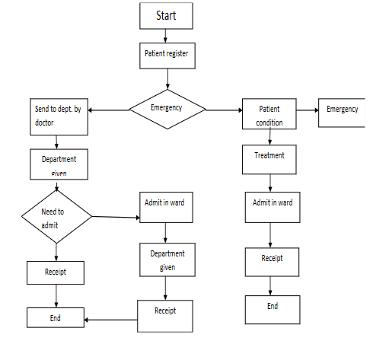
Diagram of Proposed System

Slide 7

Modules Description
GETTING INTO THE PROJECT:
Hospital Management System in php and mysql. This system has a ‘Home’ page from where the patient, doctor & administrator can login into their accounts by toggling the tabs accordingly.
'About Us' page allows us to get some more information about the quality and the services of the hospital.
‘Contact’ page allows users to provide feedback or queries about the services of the hospital shows the ‘Contact’ page.

Slide 8
The ‘Home’ page consists of 3 modules:
Patient Module
The Dashboard page allows patients to perform two operations:
1. Book his/her appointment:
2. View patients’ Appointment History:
2. Doctor Module
The doctors can login into their account which can be done by toggling the tab from ‘Patient’ to ‘Doctor’. Registration of a doctor account can be done only by admin. We will discuss more about this in Admin Module
Once the doctor clicking the ‘Login’ button, they will be redirected to their own dashboard

Slide 9
3. Admin Module
This module allows admin to perform five major operations:
View the list of all patients registered:
View the list of all doctors registered:
View the Appointment lists:
Add Doctor:
View User’s feedback/Queries:

Slide 10
System Requirements
1. Software Requirement:
Database: MS ACCESS using c# Framework: ASP.Net Design: HTML, CSS
2. Hardware Requirement:
Dual core processor RAM 1GB HDD min 40GB

Slide 11

Conclusion
By implementing this web based application the website and customized application on the tablet. The management of the patients will be very much easier, efficient and less time consuming.
It will be easy for the doctors and patient to access the records and reports as the history and reports are already present in the system ,so the patient will not have to carry all the reports and big x-rays and MRI films etc.
The patient details are already present in the database while registration so there is no need to fill a form during emergency cases. The doctors can check details of the patients on their system, provide prescription on a click which will be sent to the pharmacist this will reduce a huge amount of time as the pharmacist knows which medicines to be kept ready before hand, the communications among the doctor and patient is enhanced as the patient can get as much help online. It will help to reduce many manual efforts,time taken and cost.

Slide 12
References
[1] Measuring the Quality of Health Care: A statement of the National Roundtable on Healthcare Quality Division of Healthcare Services: National Academy Press; 1999. [2] Pine M, al e. International Journal for Quality in Health Care 1998; 10(6):491–501. [PubMed] [3] Software Engineering by K.K. Aggrawal, Singh, Yogesh. [4] Mills D, editor. Report on the Medical Insurance Feasibility Study. San Francisco, CA: California Medical Association; 1977. [5] EMBASE. In. The Netherlands: Elsevier Science Publishers B.V

Slide 13
Thank You ☺

